Slide 1
3a. UTXO vs. Account Model
https://academy.horizen.io/technology/expert/utxo-vs-account-model/

Slide 2
Introduction
A blockchain is a stateful system. Its entire purpose is to record past events and user interactions. With each new block the system undergoes a state transition that happens according to the state transition logic defined in its protocol.
The difference between the UTXO and the account model lies in the way the bookkeeping is handled. With bookkeeping, we mean recording the state and transitioning from one state to another.
The first significant difference between the two balance models is how the state of the system is recorded. In the UTXO model, the movement of assets is recorded as a directed acyclic graph (DAG) between addresses, whereas the account model maintains a database of network states.

Slide 3
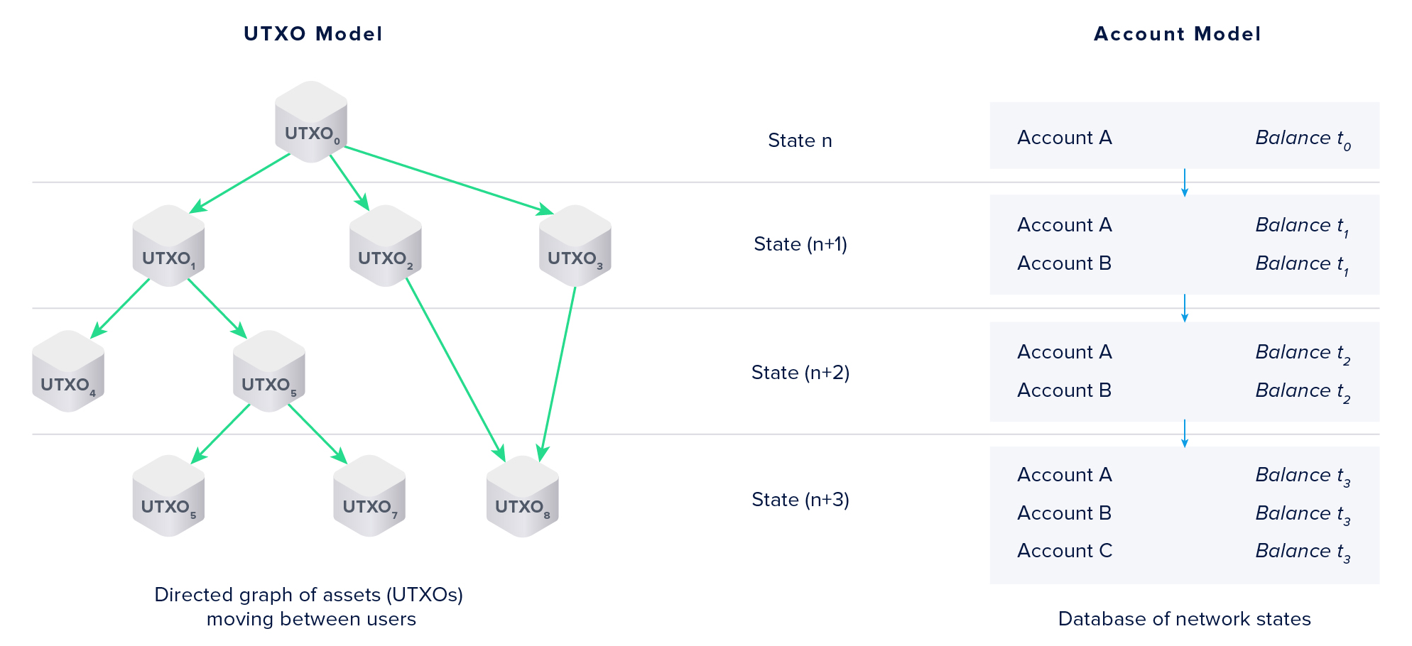
Recording the State of the System (1/2)

Slide 4
Recording the State of the System (2/2)
In the UTXO model, the entire graph of transaction outputs, spent and unspent, represents the global state.
Directed acyclic graphs don’t allow circular relationships between nodes.
An unspent transaction output does not have an edge originating from it.
In the account model, only the current set of accounts and their balances represents the global state.
Conceptual difference:
The account model updates user balances globally.
The UTXO model only records transaction receipts. In the UTXO model, account balances are calculated on the client-side by adding up the available unspent transaction outputs (UTXOs).

Slide 5
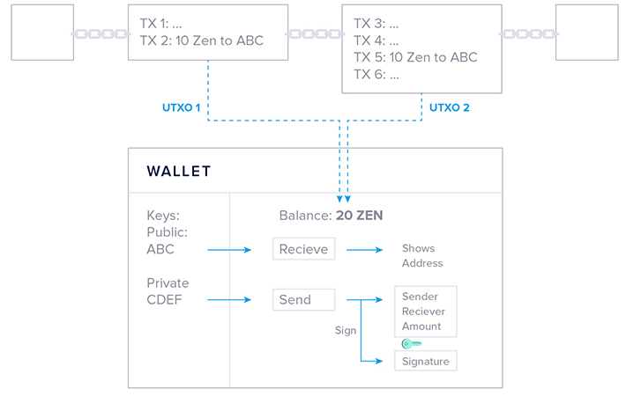
The UTXO Model
The UTXO model does not incorporate accounts or wallets at the protocol level. The model is based entirely on individual transactions, grouped in blocks.
Wallets maintain a record of all addresses controlled by a user and monitor the blockchain for all associated transactions. The sum of all unspent transaction outputs it can control determines the current balance.

Slide 6
State Transitions in the UTXO Model (1/2)
Each transaction in the UTXO model can transition the system to a new state, but transitioning to a new state with each transaction is infeasible.
All network participants must stay in synch on the current state. Designing a consensus mechanism that keeps all nodes synchronized becomes harder, when state transitions happen more frequently.
The shorter the period for nodes to update the state, the higher the chance of reaching an inconsistent state where some nodes have a different view of past events than others.
As a result, transactions are batched into blocks, and each new block presents a system state transition.

Slide 7
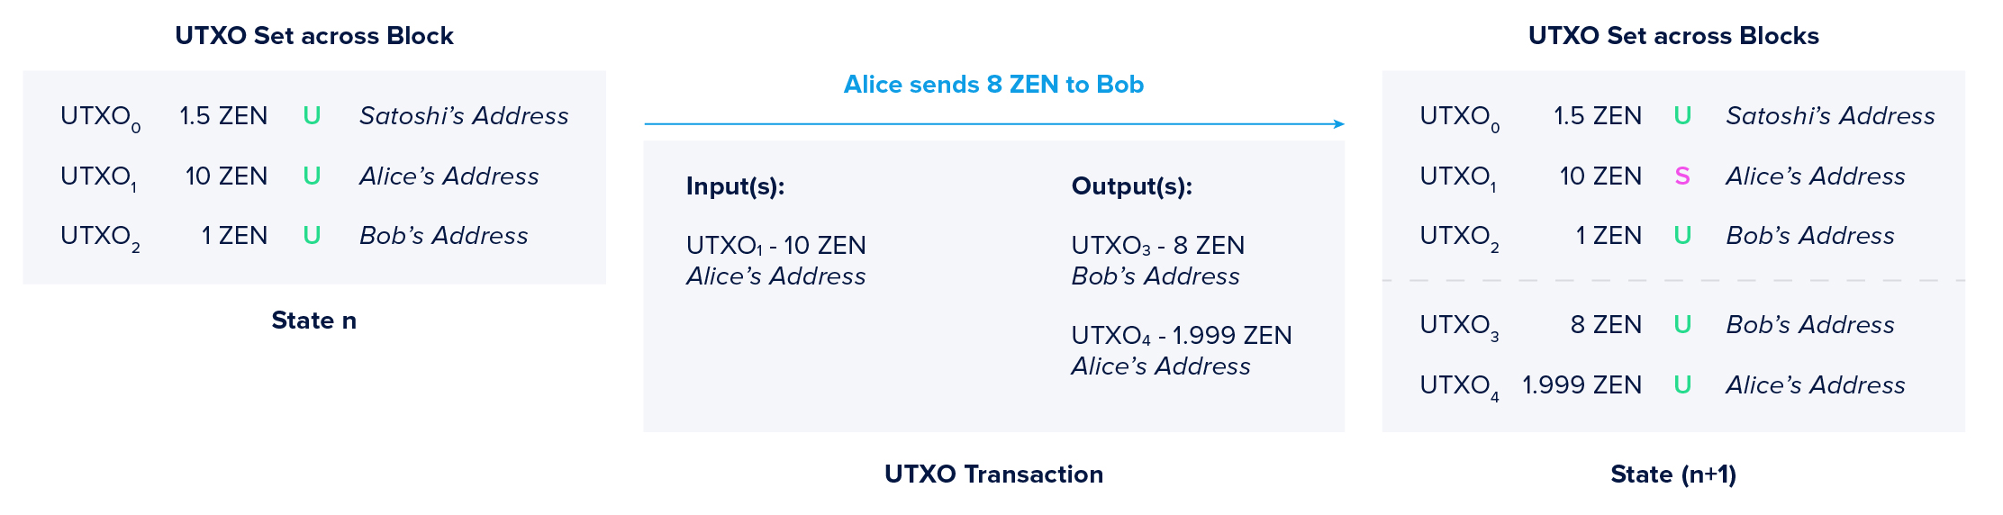
State Transitions in the UTXO Model (2/2)
In the example below, we look at a UTXO state transition with only a single hypothetical transaction for simplicity.
Spent
(new block)
The transaction fee’s size is estimated by the wallet based on the amount of data recorded on-chain. Miners will typically pick the transactions with the highest fees per byte.

Slide 8
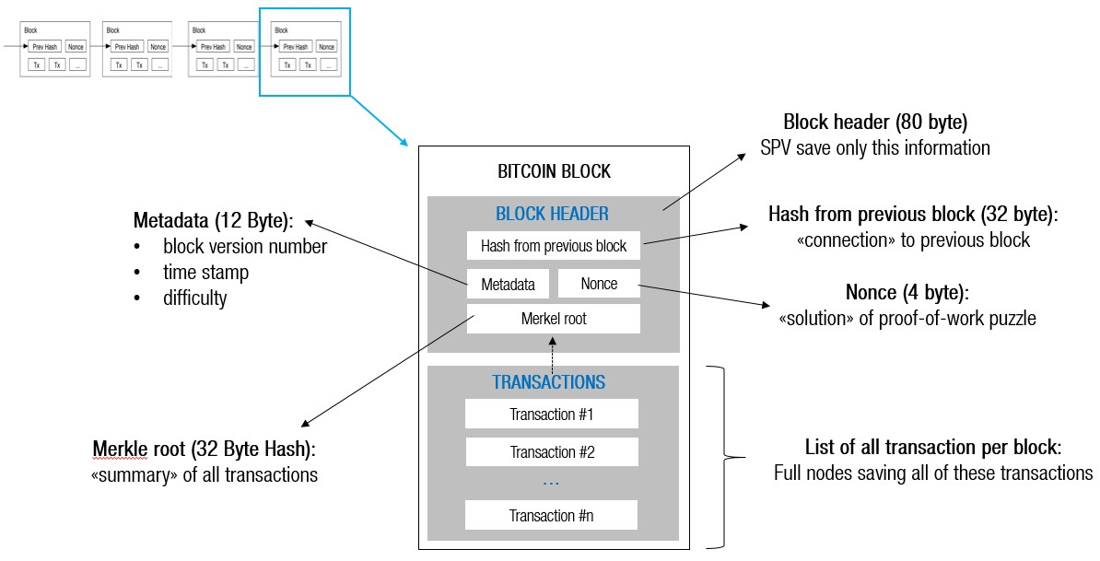
Ref. Bitcoin Block Structure
https://marcsteiner-consulting.ch/description-of-bitcoin-blocks-and-transactions

Slide 9
The Account Model (1/2)
The account-based transaction model represents assets as balances within accounts, similar to bank accounts. Ethereum uses this transaction model.
When you create an Ether wallet and receive your first transaction, a private key controlled account (EOA) is added to the global state and stored across all nodes on the network.
Smart contracts can hold funds themselves, which they can redistribute according to the conditions defined in the contract logic.
Every account in Ethereum has a balance, storage, and code-space for calling other accounts or addresses.
A transaction in the account-based model triggers nodes to decrement the balance of the sender’s account and increment the balance of the receiver’s account.

Slide 10
The Account Model (2/2)
To prevent replay attacks, each transaction in the account model has a nonce attached. Each account in Ethereum has a public viewable nonce that is incremented by one with each outgoing transaction. This prevents the same transaction being submitted to the network more than once.
Transaction fees also work differently in the account model: they are calculated based on the number of computations required to complete the state transition.
The main difference comes down to the global state in the UTXO model being only extended with new UTXOs, whereas in the account model, the global state is updated and balances change.
Ref. Ethereum State Trie Architecture Explained

Slide 11
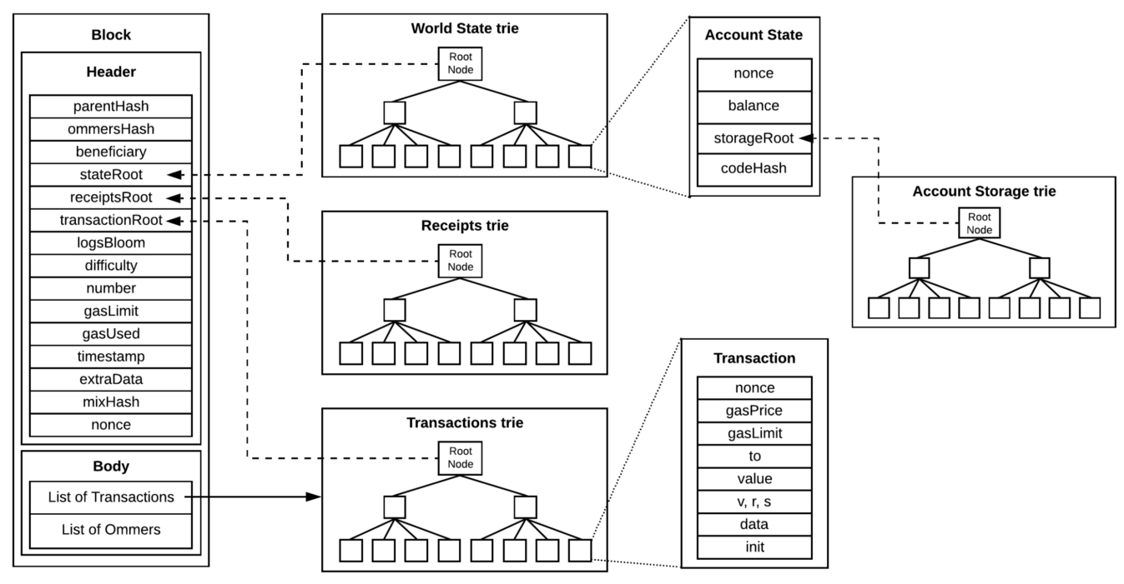
Ref. Ethereum Block Structure
https://medium.com/coinmonks/ethereum-under-the-hood-part-7-blocks-c8a5f57cc356

Slide 12
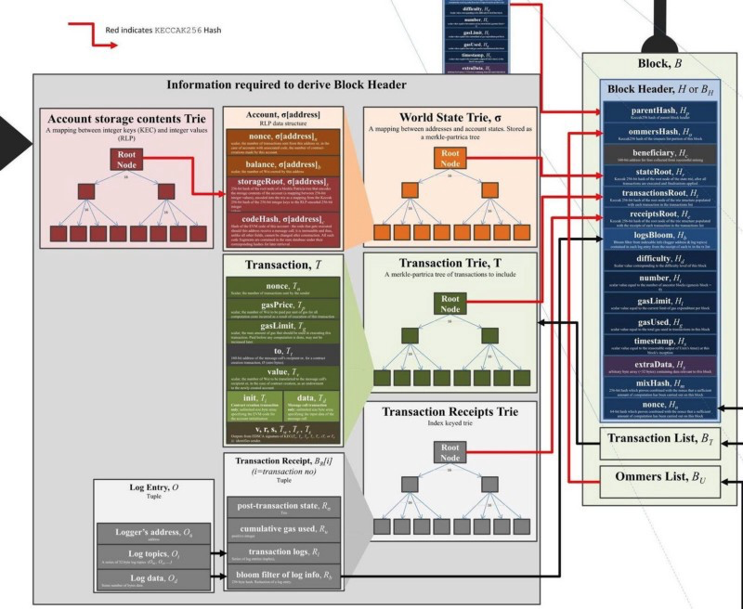
Ref. Ethereum State Trie Architecture (1/3)
Modified Merkle Patricia Trie is used as the main data structure in Ethereum tries: receipt trie, world state trie, account storage trie, and transaction trie.
Ethereum State Trie Architecture Explained

Slide 13
Ref. Ethereum State Trie Architecture (2/3)
Three main state tries: world state trie, transaction trie, and receipt trie are stored in the block. And, account storage trie (account storage contents trie) construct leaf node in world state trie.
World state trie is a mapping between addresses and account states. It can be seen as a global state that is constantly updated by transaction executions. All the information about accounts are stored in world state trie and you can retrieve information by querying it. World state trie is closely related to account storage trie because it has “storageRoot” field that points the root node in account storage trie.
Account state stores information about accounts such as how much the account has and how many transactions were sent from the account. It has four fields: nonce, balance, storageRoot, and codeHash. It is a leaf node in world state trie.

Slide 14
Ref. Ethereum State Trie Architecture (3/3)
Account Storage Trie is where data associated with an account is stored. This is only relevant for Contract Account and all smart contract data is persisted in the account storage trie as a mapping between 32-bytes integers.
Transaction trie records transactions in Ethereum. As Transaction Trie is constructed with Modified Merkel Patricia Trie, the only root node is stored in the block. (For contract creation, the field init in this trie is filled with an EVM byte-code that generates a new contract. The result of the constructor invocation is the contract itself as it returns body of new contract, associated via the account field codeHash.)
Transaction Receipt Trie records receipts (outcome) of transactions. The receipt is a result of the transaction which is executed successfully. The receipt includes a hash of transaction, block number, amount of gas used, and address of contract, etc.
Ref. Ethereum Data Structures: https://arxiv.org/pdf/2108.05513.pdf

Slide 15
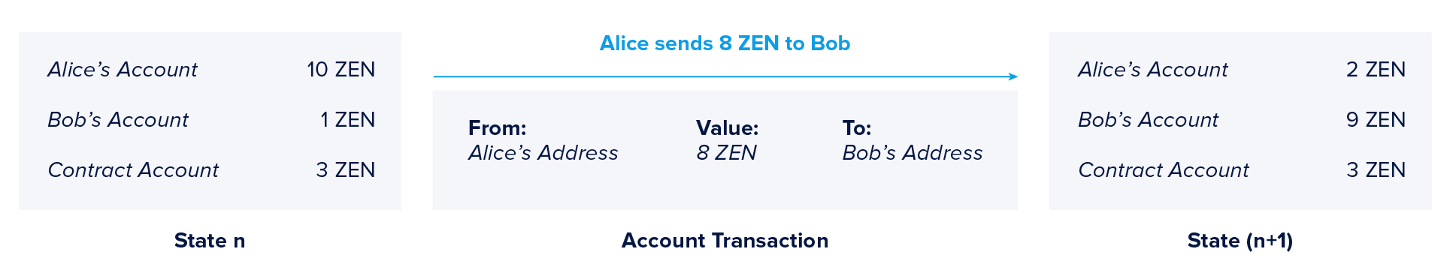
State Transitions in the Account Model
Just like in the UTXO model, it is infeasible to transition the system to a new state with every transaction without risking an inconsistent state. Transactions are also batched into blocks in the account model, and with each new block, the system transitions to a new state.
Simple example where a single transaction transitions the system to a new state below.
(new block)
Where in the UTXO model part of the verification process is checking if a transaction output in unspent, nodes in the account model check if the sender’s balance is larger than or equal to the transferred amount.

Slide 16
Comparing the UTXO and Account Model (1/4)
The UTXO model is a verification model.
Users submit transactions that specify the results of the state transition, defined as new transaction outputs spendable by the receiver(s).
Nodes then verify if the consumed inputs are unspent and if the signature(s) satisfy the spending conditions.
The account model is a computational model.
Users submit transactions instructing nodes on what state transitions should look like.
The network then computes the new state based on the instructions.
This method comes with specific implications regarding second layer scalability solutions like state channels and sharding.

Slide 17
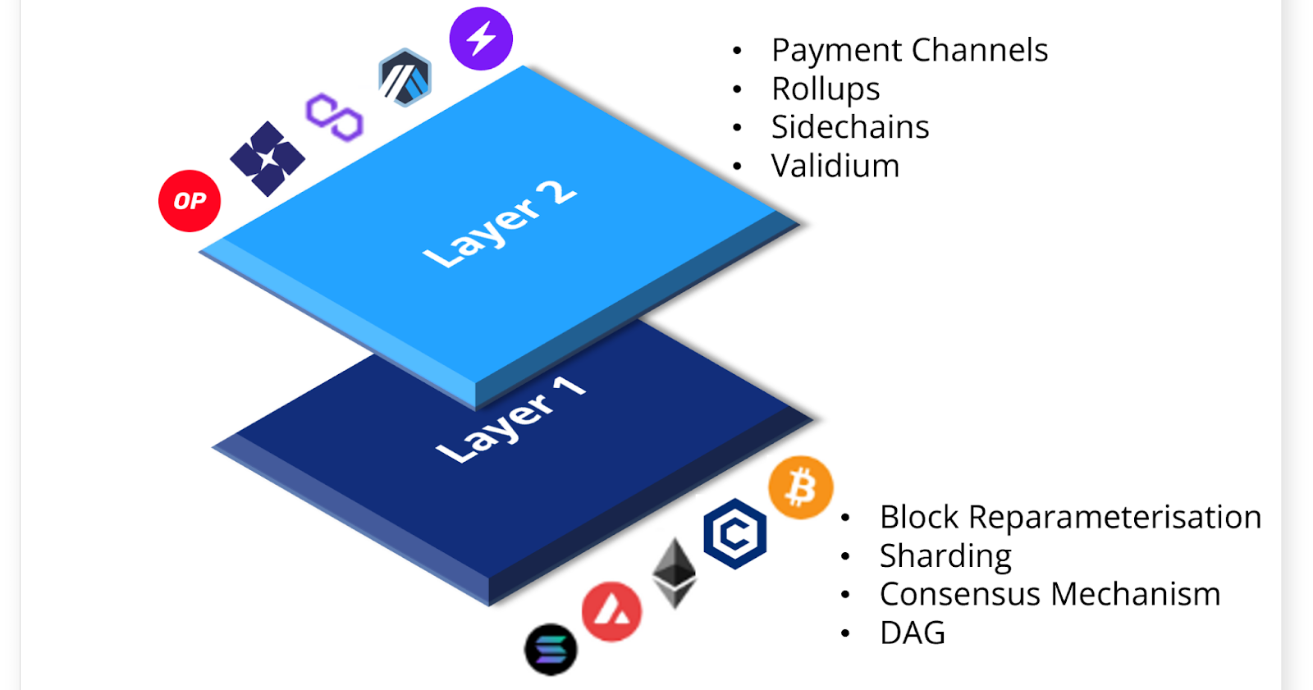
Comparing the UTXO and Account Model (2/4)
Scalability
Size of the Blockchain: The account model has more efficient memory usage. Storing a single account balance saves memory compared to storing several UTXOs that comprise a user’s total balance.
Since it is possible to process multiple UTXOs at the same time, it enables parallel transactions and encourages scalability innovation, including sharding (Layer 1 scaling) and State- and Payment Channel Constructions (Layer 2 scaling).
https://crypto.com/research/scaling-blockchains

Slide 18
Comparing the UTXO and Account Model (3/4)
Privacy
When change addresses are consequently used in the UTXO model, it makes tracking the ownership of coins harder compared to the account model.
With regard to fungibility, the account model offers better privacy. There is complete transparency of UTXO movements (read as assets) in the UTXO model when no privacy-preserving techniques are applied. When an account is funded with several transactions, the result is a single balance. When a payment from this account is made, an observer cannot determine which of the incoming coins is being spent.
Smart Contract Capabilities
The account model offers clear advantages when it comes to enabling smart contracts.

Slide 19
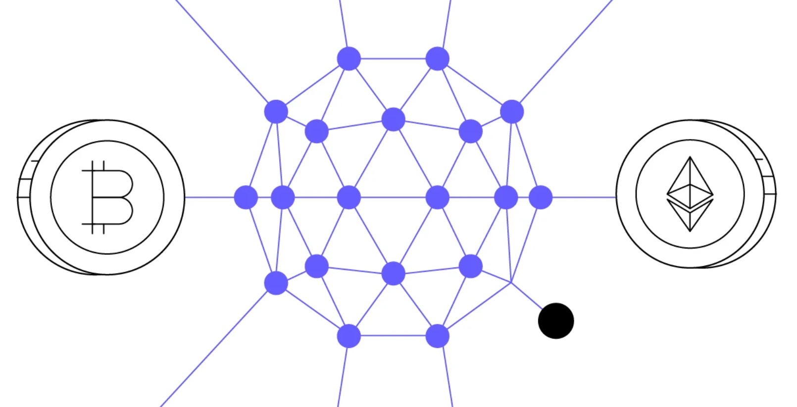
Comparing the UTXO and Account Model (4/4)
A key takeaway is that the UTXO model is better when dealing with simple transactions. The account model is beneficial when dealing with more complex logic.
Hence a popular trend with current smart contract platforms is using a hybrid model where the UTXO model is used for balances, and the account model is used for smart contracts.
Qtum is an innovative UTXO-based blockchain that is smart contract-capable and compatible with the Ethereum Virtual Machine (EVM).
Qtum (QTUM): A Hybrid Blockchain Merging Bitcoin and Ethereum

Slide 20
Ref. Understanding Cardano Extended-UTXO
https://medium.com/coinmonks/understanding-cardano-extended-utxo-950ae19829cf
Very good article comparing UTXO with Account-based Models
Cardano uses the Extended UTXO model, abbreviated EUTXO. The purpose is to support higher expressiveness of programmability while maintaining all the benefits of Bitcoin’s UTXO model.
EUTXO offers some advantages over the account-based model. In particular, greater security when executing smart contracts, fee predictability, local verification ensuring that transactions will be accepted after the submission, and an inherently fragmented blockchain state. This allows parallelization in transaction processing, which has a positive effect on on-chain scalability.

